Slide 1

Bank Loan Case Study Final Project-2
By Abhilekh Sarmah

Slide 2

Project Description
As a data analyst at a finance company, firstly I analyzed the given loan dataset using Exploratory Data Analysis (EDA) to identify patterns which were linked to loan defaults, which helped to optimize approval decisions. The objectives were to minimize the financial losses from defaults and avoid rejecting capable applicants. Depending on the task or situation given, I reviewed the data, adapted my approach, made necessary adjustments(if necessary) and solved problems in Excel using formulas (e.g., `COUNT`, `CORREL`), pivot tables, and visualizations like bar charts, box plots, pie charts, and heatmaps. This structured method provided me with insights into key default indicators, thus enhancing loan risk assessment.

Slide 3
Approach
To tackle the loan default project, I used a structured Exploratory Data Analysis (EDA) approach using Excel. I started with data cleaning, handling missing values using functions like `COUNT`, `ISBLANK`, and `IF`, and imputing with the respective `Median`. Outliers were identified with `QUARTILE` and `IQR`, then visualized using box plots. I assessed the data imbalances using `COUNTIF` and `SUM`, shown in pie charts. For EDA, I performed:
Univariate analysis
Segmented analysis
Bivariate analysis
Using `CORREL`, I identified key default indicators. Pivot tables, Excel functions, and charts provided me with actionable insights for the loan approvals.

Slide 4
Tech Stack Used
Microsoft Excel 2021 Version

Slide 5

Data Cleaning Process
First and foremost the given data was analysed and then Blanks were identified using ‘CountBlank’ Formula in Excel.
The next step was to replace the blanks with the ‘Median’ of the respective column using ‘Find&Replace’.
Also many unnecessary columns were replaced which were not related to our analysis, hence only the relevant columns remained.
Some of the removed columns include the follow:
EXT_SOURCE_1;
EXT_SOURCE_2 ;
EXT_SOURCE_3 ;
APARTMENTS_AVG ;
BASEMENTAREA_AVG;
YEARS_BEGINEXPLUATATION_AVG ;
YEARS_BUILD_AVG ;
COMMONAREA_AVG ;
ELEVATORS_AVG ;
ENTRANCES_AVG , etc.

Slide 6
Data Cleaning Process(For Categorical Data)
For columns like Name_Type_Suite & Occupation_Type which include categorical data, we replace the blanks with the Mode or the Highest occurring data in both the cases,
In case of Type_Suite, we observe that the highest occurring data is ‘Unaccompanied’, hence in the Data Cleaning process in the respective column, we replace the blank with ‘unaccompanied’.
In case of Occupation_Type, we observe that the highest occurring data is ‘Laborers’, hence in the Data Cleaning process in the respective column, we replace the blank with ‘Laborers’.

Slide 7
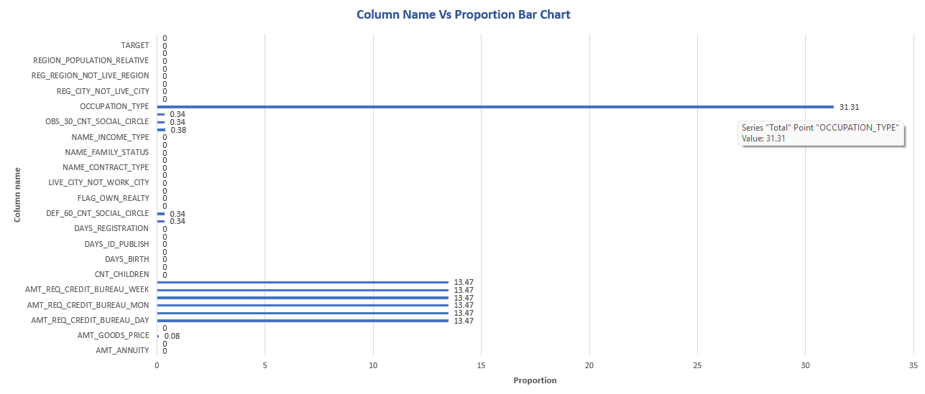
Task 1(Data Cleaning Process)
The data cleaning steps including dealing with blank values and replacing them with Median/Mode as per requirements has already been done in the Data Cleaning Process.
We observe from the Bar Chart, that the column having the highest proportion is Occupation Type and here the blanks were replaced with the highest categorical value i.e. Laborers.

Slide 8
Insights derived from Task 1
It was observed that specific columns were very well recorded and had no blanks in them, whereas other columns were not well recorded and 1/3rd of the data was missing in Specific columns.
We observe from the Bar Chart, that the columns AMT_REQ_CREDIT_BUREAU_WEEK/DAY/MONTH had the same proportion of blanks and a lot of data was missing, hence highlighting ineffective data collection for the respective columns.

Slide 9
Task 2(Outlier Detection Process)
In this Outlier Detection process, I found out the outliers for several columns using Excel’s functions like Quartile, IQR and also highlighted the Outliers using conditional formatting.
In finding the IQR, I have used a Fence Factor of 1.5 to find the required output.
Further I created box plots or scatter plots to visualize the distribution of numerical variables and highlight the outliers.

Slide 10
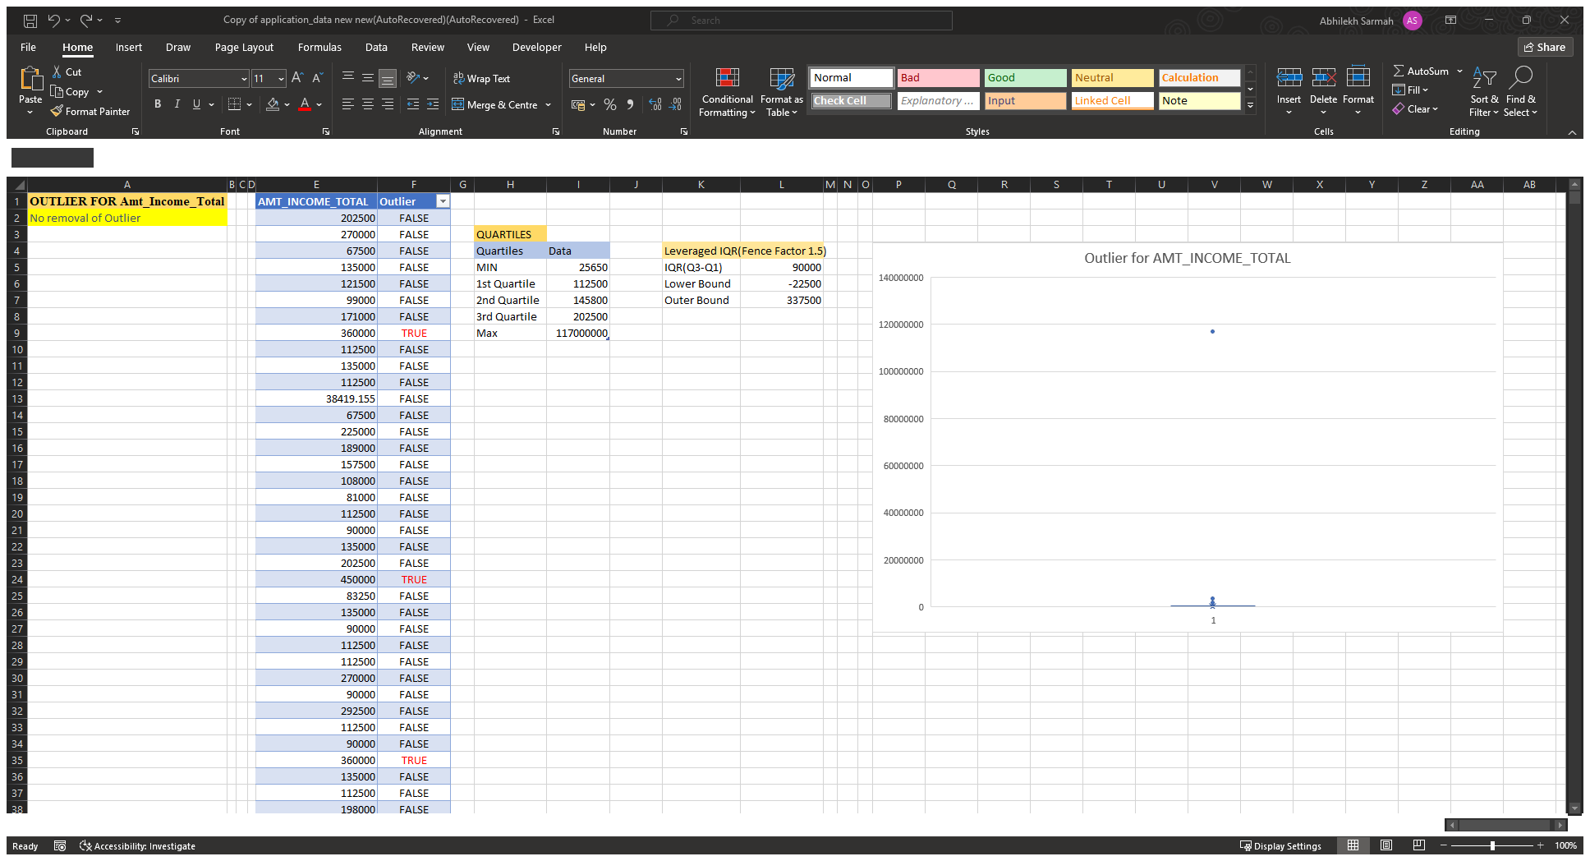
Outlier Detection(Amt_Income_Total)

Slide 11
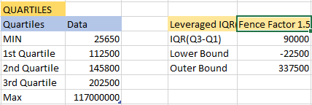
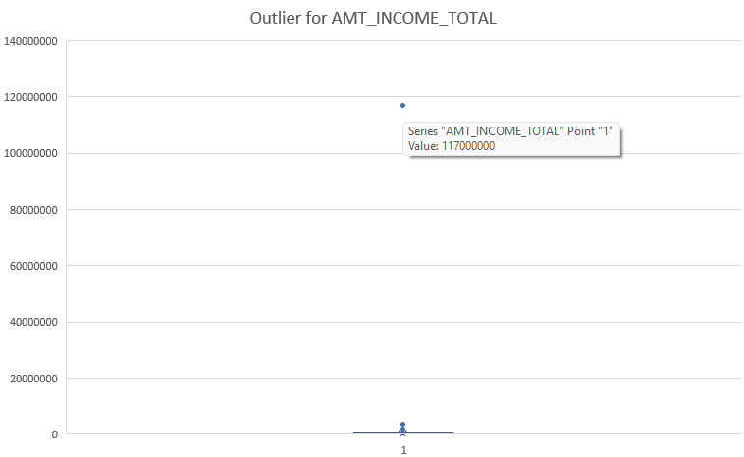
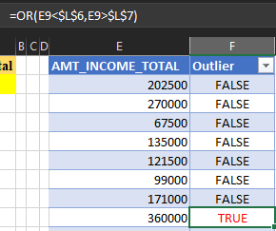
Outlier Detection(Amt_Income_Total)
Firstly, the Max/Min & Quartiles are calculated using the Quartile.INC formula
I used the Box&Whisker Chart to identify the extreme Outlier which stands at a value of 117000000.
Other Outliers were identified using the ‘Or’ function in Excel

Slide 12
Outlier Detection(Amt_Income_Total)
Insights Derived
Since the total income earned by an individual varies from person to person, hence there were no changes in the extreme Outlier detected.

Slide 13
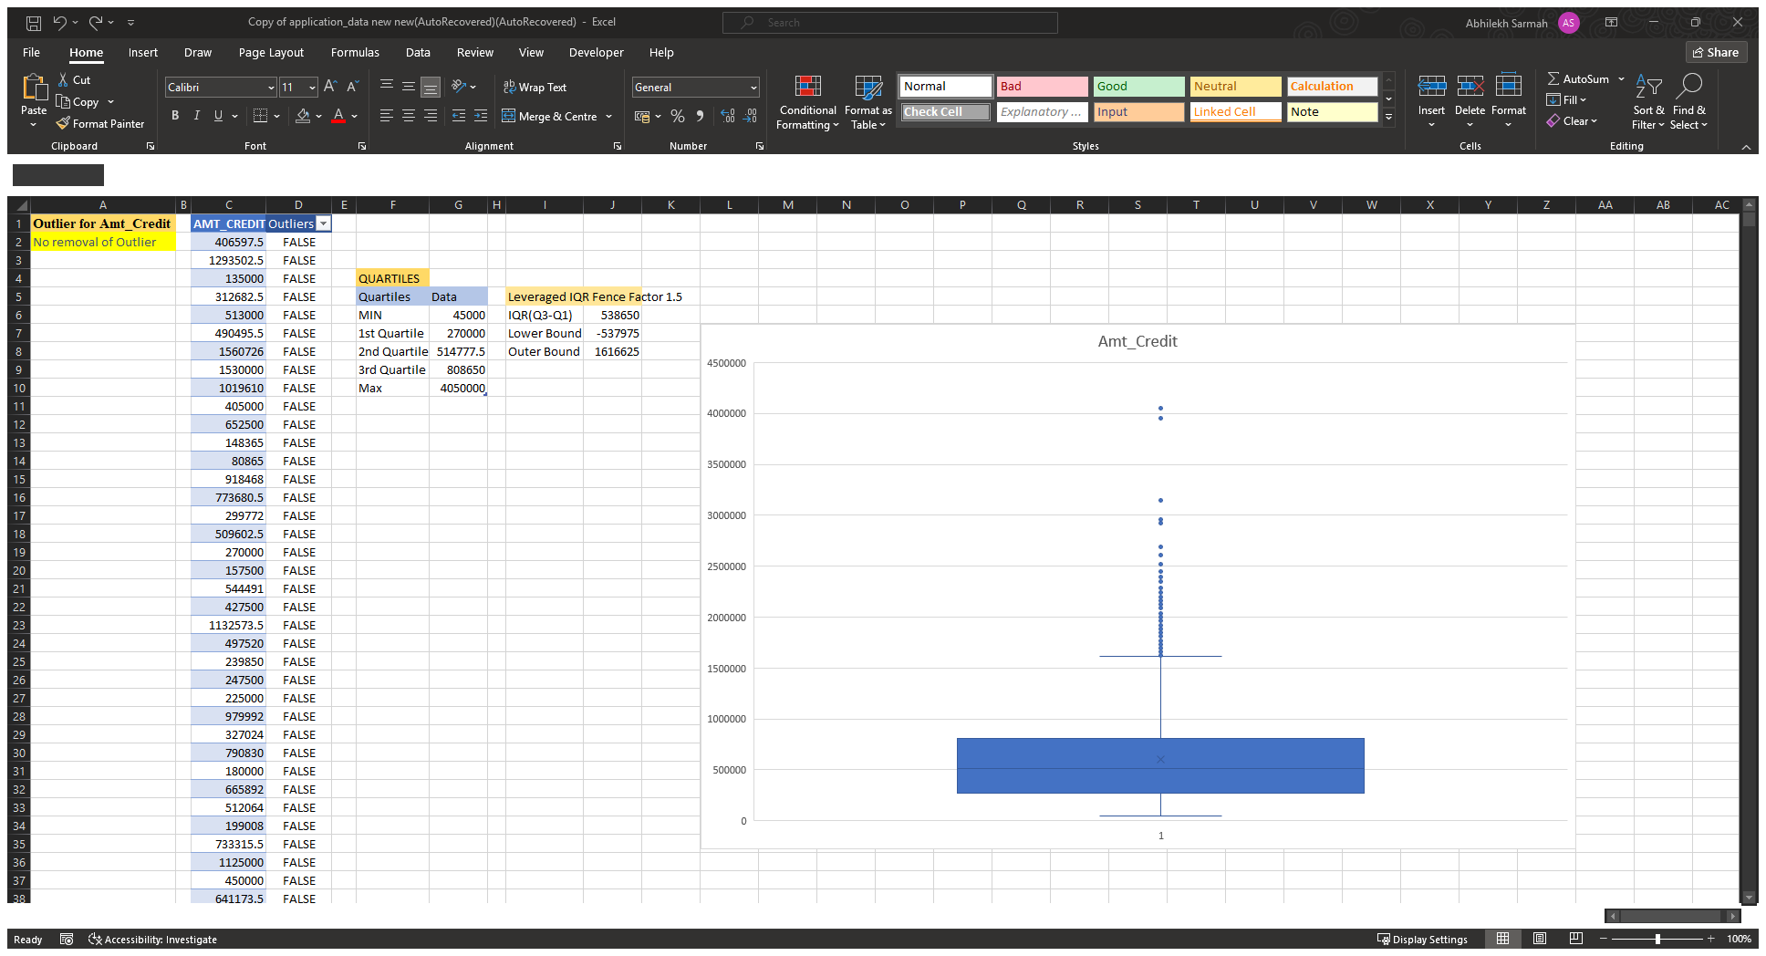
Outlier Detection(Amt_Credit)

Slide 14
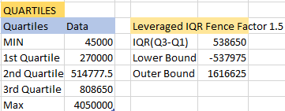
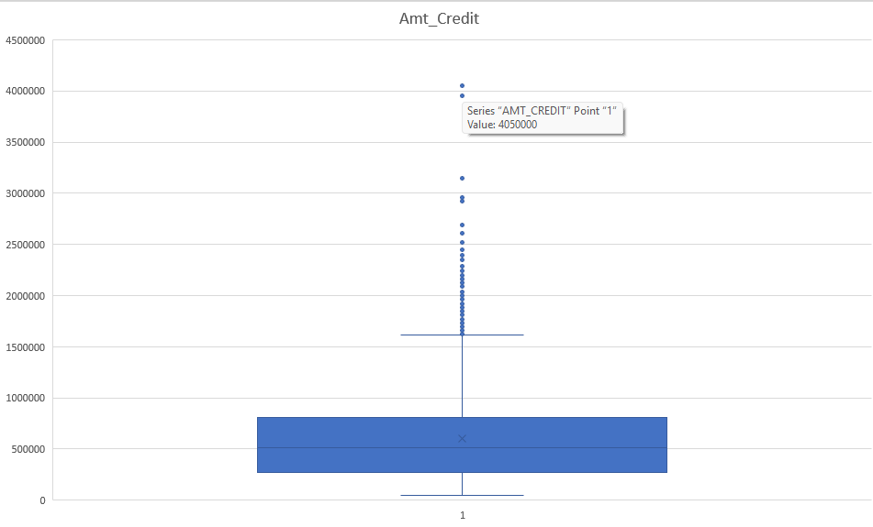
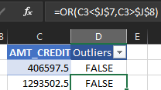
Outlier Detection(Amt_Credit)
Firstly, the Max/Min & Quartiles are calculated using the Quartile.INC formula
I used the Box&Whisker Chart to identify the extreme Outlier which stands at a value of 4050000.
Other Outliers were identified using the ‘Or’ function in Excel

Slide 15
Outlier Detection(Amt_Credit)
Insights Derived
Since the amount credited for an individual varies from person to person, hence there were no changes in the extreme Outlier detected.

Slide 16
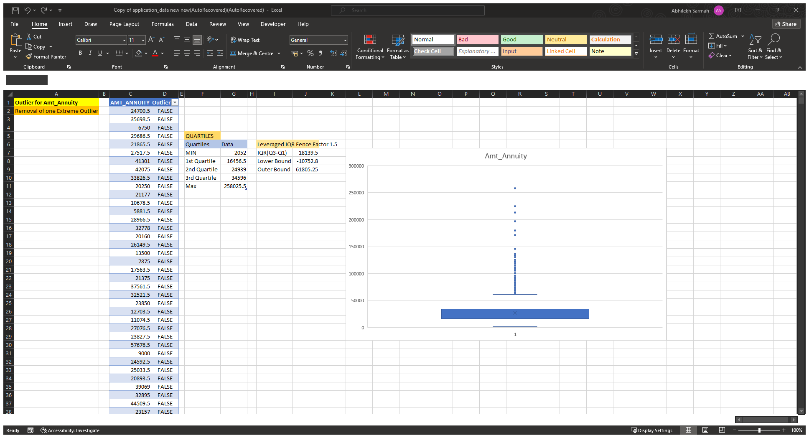
Outlier Detection(Amt_Annuity)

Slide 17
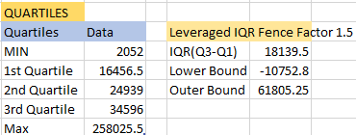
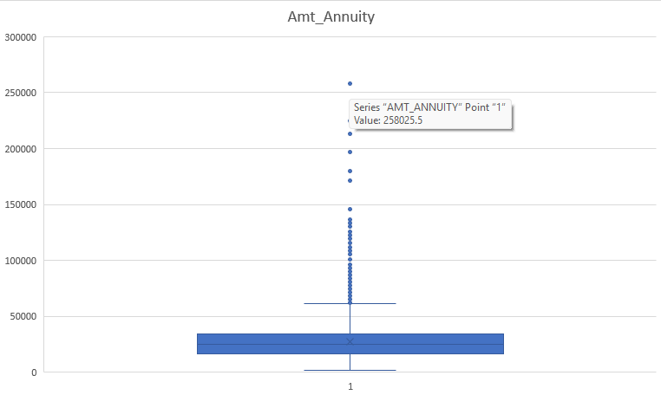
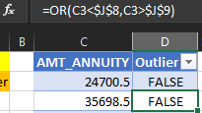
Outlier Detection(Amt_Annuity)
Firstly, the Max/Min & Quartiles are calculated using the Quartile.INC formula
I used the Box&Whisker Chart to identify the extreme Outlier which stands at a value of 258025.5
Other Outliers were identified using the ‘Or’ function in Excel

Slide 18
Outlier Detection(Amt_Annuity)
Insights Derived
The extreme Outlier which stands at a value of 258025.5 is being replaced with the median value of 24939 using Excel’s “Find & Replace” function.
Though there were other outliers found, we replaced only the extreme outlier as replacing each and every outlier would be ineffective.

Slide 19
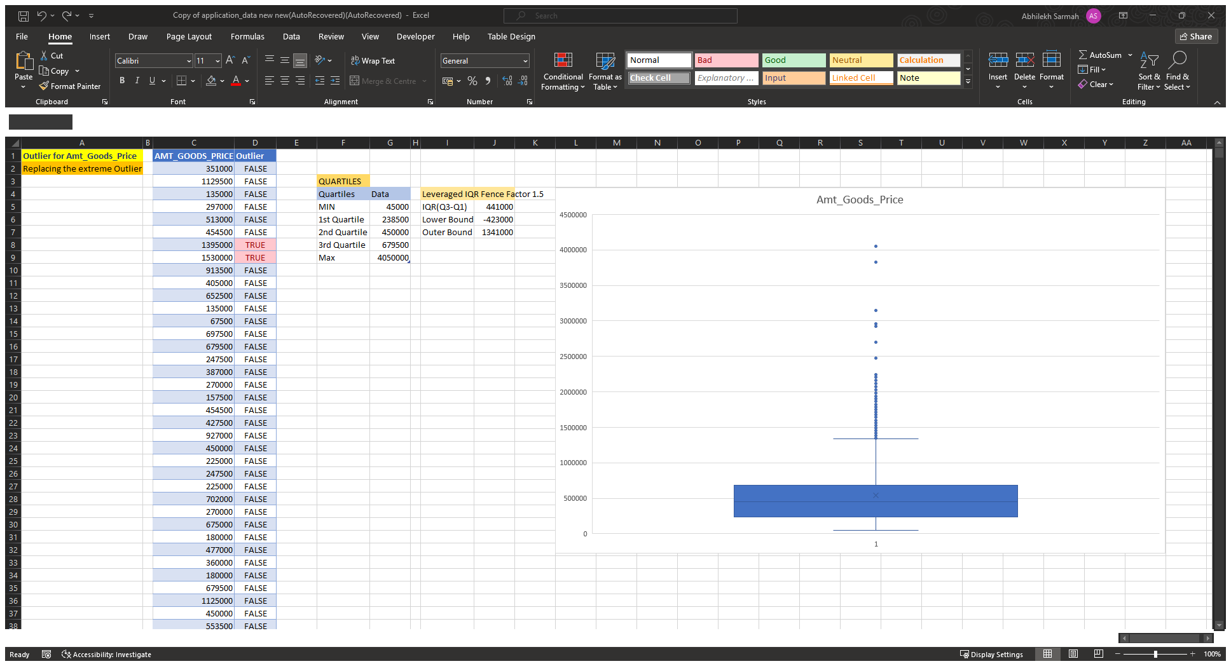
Outlier Detection(Amt_Goods_Price)

Slide 20
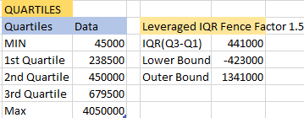
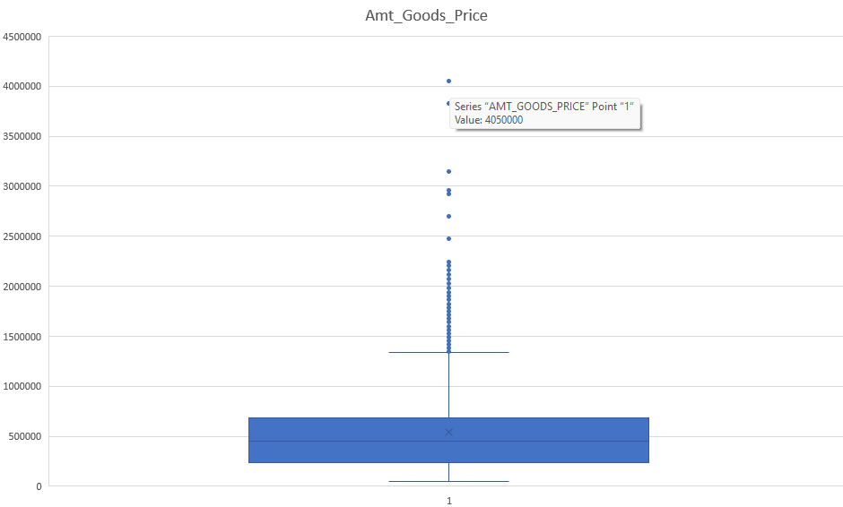
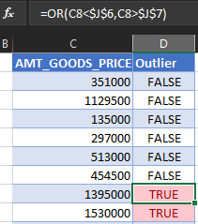
Outlier Detection(Amt_Goods_Price)
Firstly, the Max/Min & Quartiles are calculated using the Quartile.INC formula
I used the Box&Whisker Chart to identify the extreme Outlier which stands at a value of 4050000
Other Outliers were identified using the ‘Or’ function in Excel

Slide 21
Outlier Detection(Amt_Goods_Price)
Insights Derived
The extreme Outlier which stands at a value of 4050000 is being replaced with the median value using Excel’s “Find & Replace” function.
Though there were other outliers found, we replaced only the extreme outlier as replacing each and every outlier would be ineffective.

Slide 22
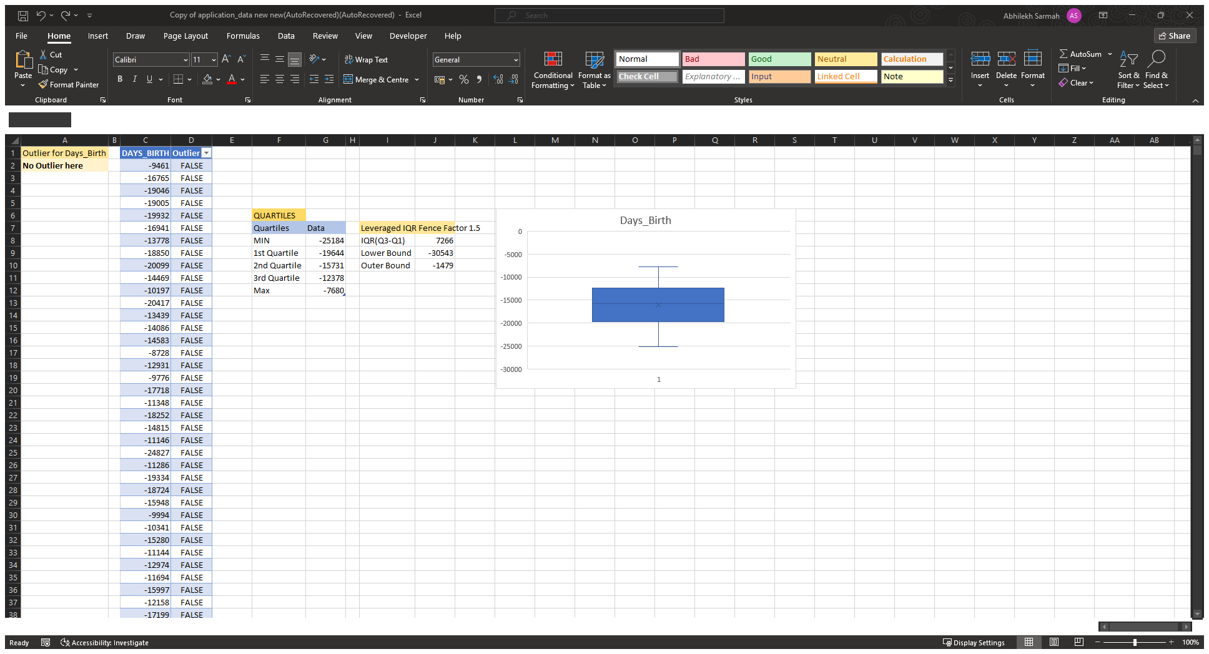
Outlier Detection(Days_Birth)

Slide 23
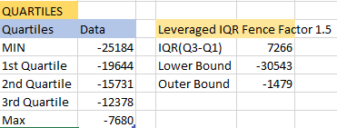
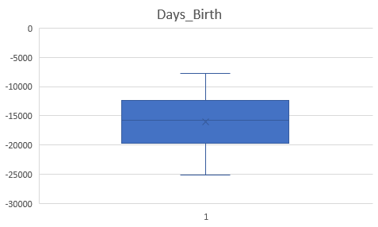
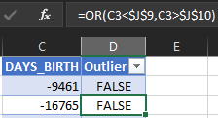
Outlier Detection(Days_Birth)
Firstly, the Max/Min & Quartiles are calculated using the Quartile.INC formula
I used the Box&Whisker Chart to identify any outliers(if exists)
Outliers were also identified using the ‘Or’ function in Excel

Slide 24
Outlier Detection(Days_Birth)
Insights Derived
In this case, all the data lied within the limits and there was no outlier detected in this column.
There was no replacement being done here.

Slide 25
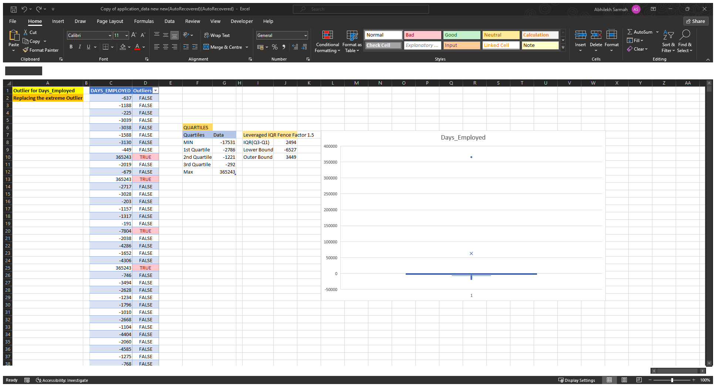
Outlier Detection(Days_employed)

Slide 26
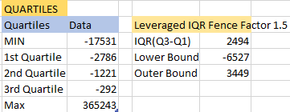
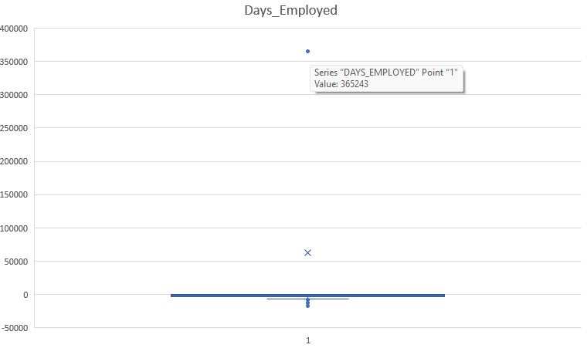
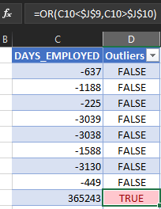
Outlier Detection(Days_employed)
Firstly, the Max/Min & Quartiles are calculated using the Quartile.INC formula
I used the Box&Whisker Chart to identify the extreme Outlier which stands at a value of 365243
Other Outliers were identified using the ‘Or’ function in Excel

Slide 27
Outlier Detection(Days_employed)
Insights Derived
The extreme Outlier which stands at a value of 365243 is being replaced with the median value using Excel’s “Find & Replace” function.
Though there were other outliers found, we replaced only the extreme outlier as replacing each and every outlier would be ineffective.

Slide 28
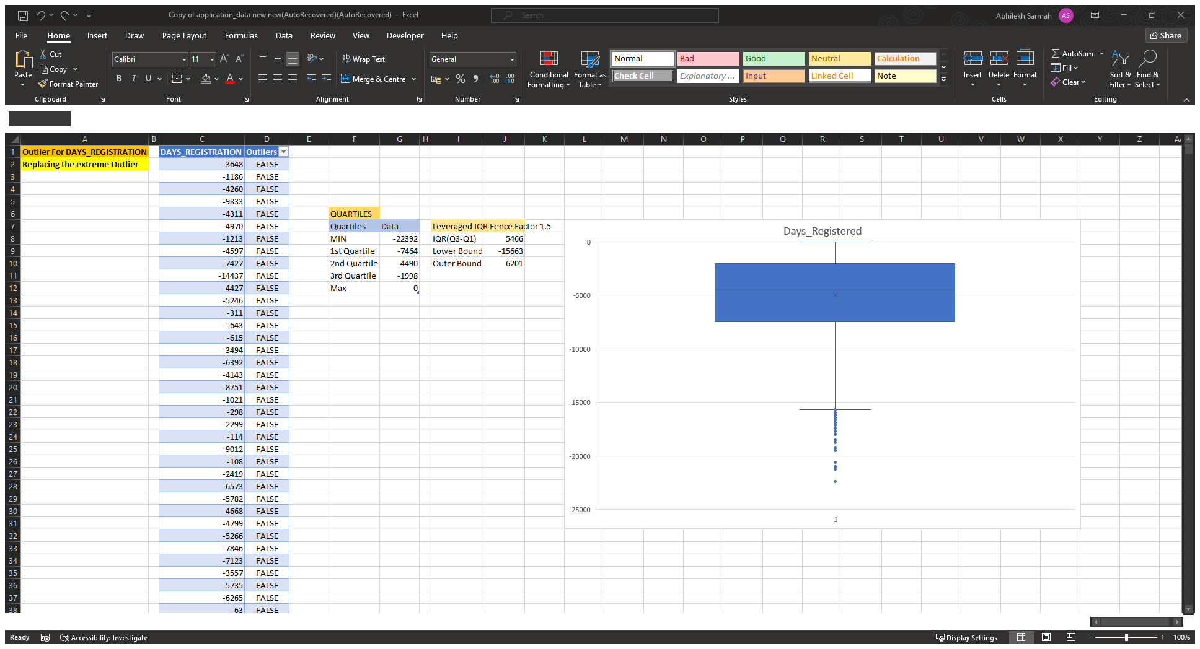
Outlier Detection(Days_registered)

Slide 29
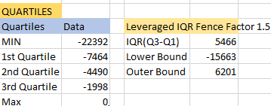
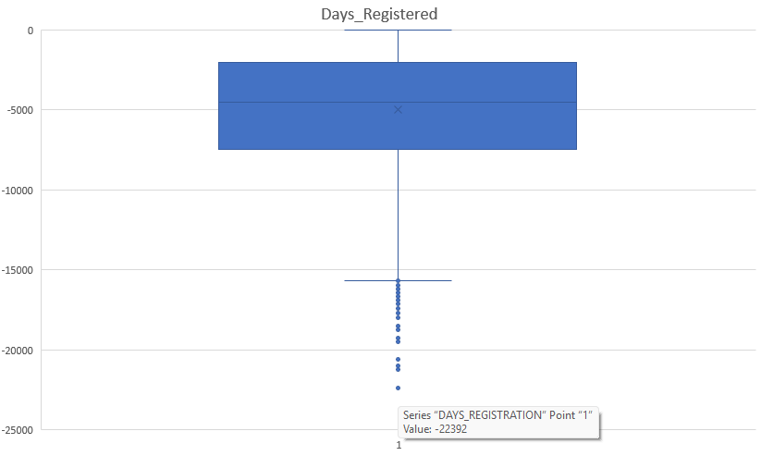
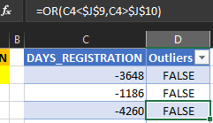
Outlier Detection(Days_registered)
Firstly, the Max/Min & Quartiles are calculated using the Quartile.INC formula
I used the Box&Whisker Chart to identify the extreme Outlier which stands at a value of -22392
Other Outliers were identified using the ‘Or’ function in Excel

Slide 30
Outlier Detection(Days_registered)
Insights Derived
The extreme Outlier which stands at a value of -22392 is being replaced with the median value using Excel’s “Find & Replace” function.
Though there were other outliers found, we replaced only the extreme outlier as replacing each and every outlier would be ineffective.

Slide 31
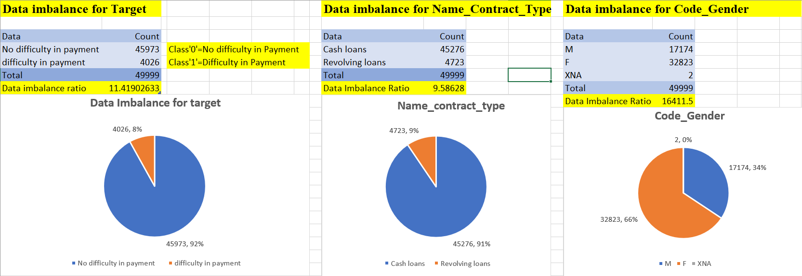
Task 3(Data Imbalance Detection Process)
This Data Imbalance Detection Process was done to identify the data imbalances present in the given dataset.
Also the ratio of data imbalances was calculated .
We used Excel’s “CountIf” function to identify the number of customers having difficulty in repaying the loans.

Slide 32
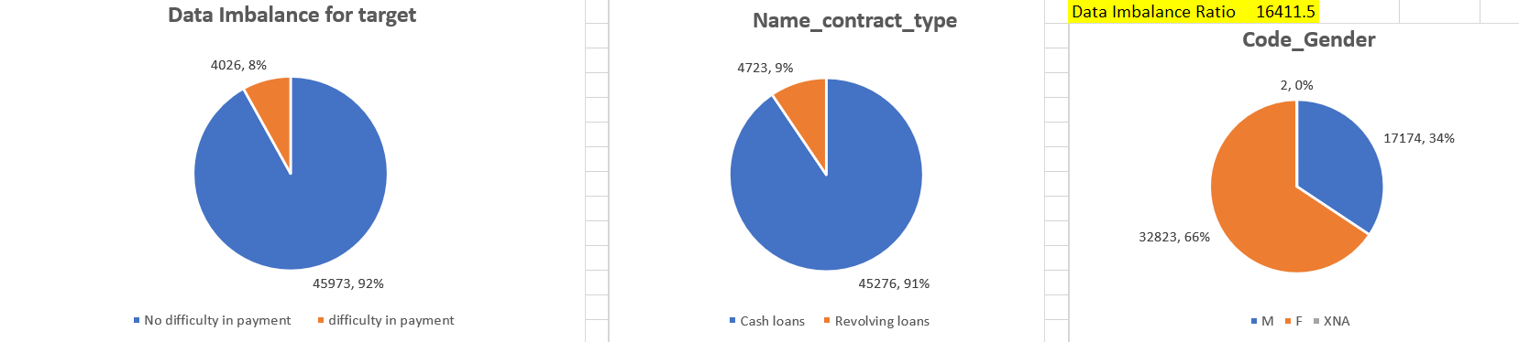
Data Imbalance Detection Process
Insights Derived
It was observed that maximum customers had no difficulty in repaying the loan, whereas only a few of them around 8% had difficulty in repaying the loan on time.
The majority of the type of loans were Cash loans while only a slight amounting to Revolving Loans(around 9%).
The majority of the customers were females which XNA amounted to an insignificant percentage of the total customers(i.e. 2%)
The maximum data imbalance amounted to the Gender column whereas the least data imbalance ratio was seen in case of Contract type.

Slide 33
Task 4(Univariate, Segmented Univariate, and Bivariate Analysis)
Here I have performed univariate analysis to understand the distribution of individual variables, segmented univariate analysis to compare variable distributions for different scenarios, and bivariate analysis to explore relationships between variables and the target variable using Excel functions and features.
I have utilized Excel functions like COUNT, AVERAGE, MEDIAN, and statistical functions for descriptive analysis. Utilize Excel features like filters, sorting, and pivot tables for segmented and bivariate analysis.
I have created histograms, bar charts, or box plots to visualize the distributions of variables. Created stacked bar charts or grouped bar charts to compare variable distributions across different scenarios. Created scatter plots or heatmaps to visualize the relationships between variables and the target variable.

Slide 34
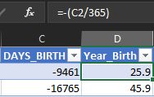
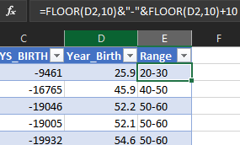
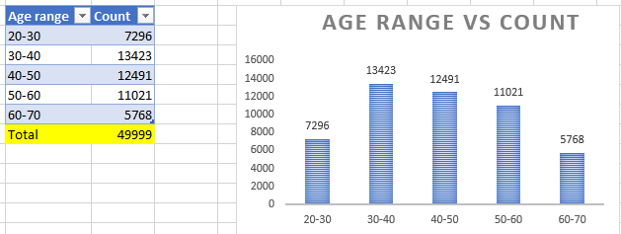
Univariate & Segmented Univariate Analysis For Age
In this step, I firstly converted the days to years using the formula below:
In the next step, I segregated the years into class intervals using the “Floor” formula
in Excel as follows:
It was observed that the maximum customers lied in the age group of 30-40 while the least lied in the age group of 60-70

Slide 35
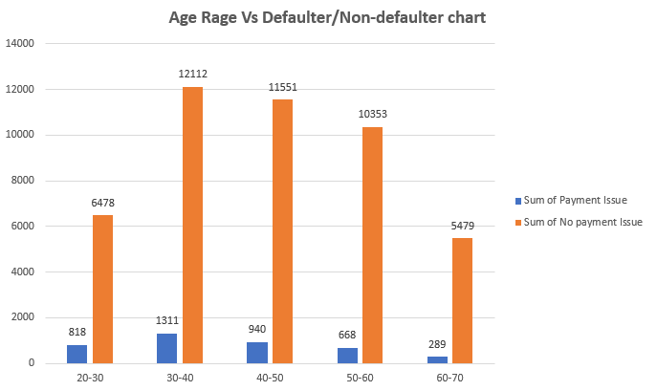
Univariate & Segmented Univariate Analysis For Age
We used the Excel’s Countif function to identify the age range with the maximum payment issues.
We used the Excel’s Countif function to identify the age range with the minimum payment issues.

Slide 36
Univariate & Segmented Univariate Analysis For Age
Insights Derived
It is observed that the age group of 30-40 had the most number of payment issues, whereas the age group of 60-70 had the least number of payment issues.
It is observed that the default rate decreases with age: 20-30 (11.2%), 30-40 (9.8%), 40-50 (7.5%), 50-60 (6.1%), 60-70 (5.0%)
It is observed that 30-40 Age Group has the highest defaulters (1,311) and non-defaulters (12,112) due to largest customer base (13,423), but default rate is moderate (9.8%)
It is observed that 60-70 Age Group has the fewest defaulters (289) due to smallest customer base (5,768) and lowest default rate (5.0%).

Slide 37
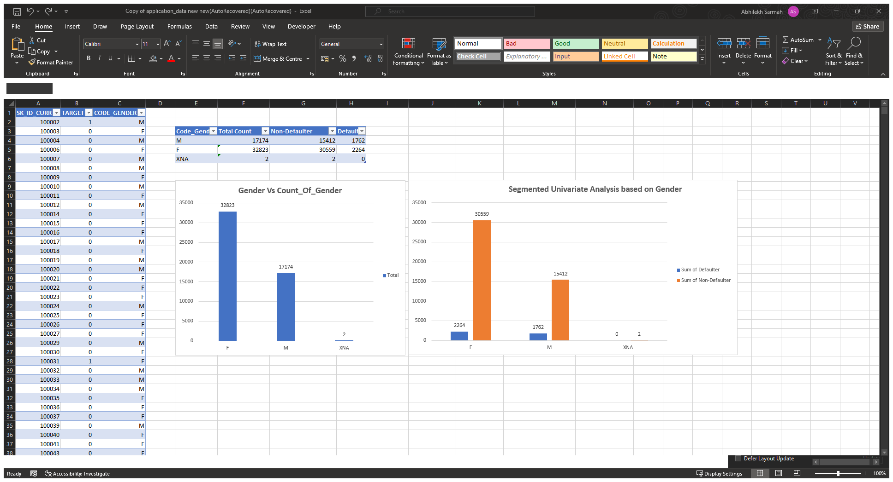
Univariate & Segmented Univariate Analysis For Gender

Slide 38
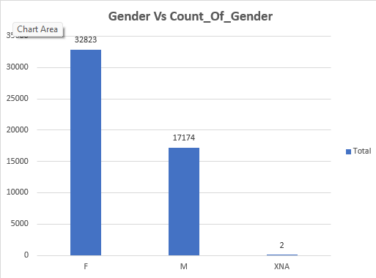
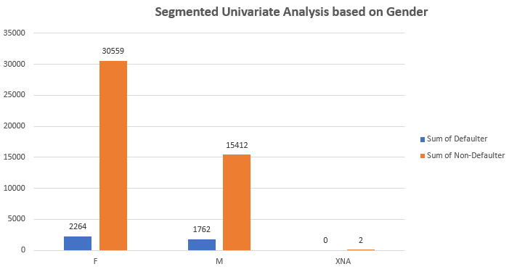
Univariate & Segmented Univariate Analysis For Gender
We used the Excel’s Countif function to identify the Gender Count for F,M & XNA.
It is observed that there were more female customers than the other genders.

Slide 39
Univariate & Segmented Univariate Analysis For Gender
Insights Derived
It is observed that Males have a higher default rate (10.3%) than females (6.9%).
It is observed that Females have more defaulters (2,264) than males (1,762), due to a larger female population (32,823 vs. 17,174).
It is observed that the XNA Category is negligible with only 2 non-defaulters and 0 defaulters, which is too small for analysis.
It is observed that the Non-defaulters (F: 30,559; M: 15,412) vastly outnumber defaulters in both genders, hence showing that defaults are rare.

Slide 40
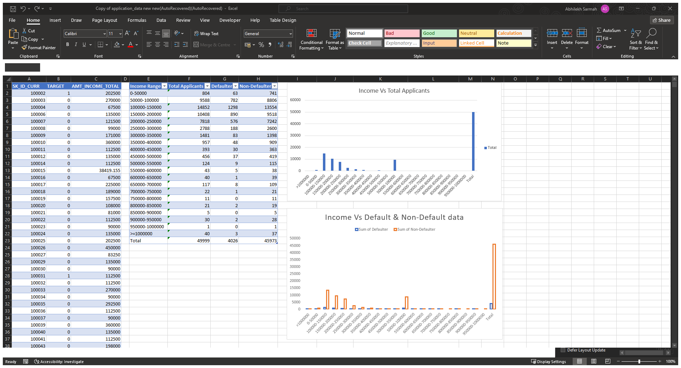
Univariate & Segmented Univariate Analysis For Amt_Income_Total

Slide 41
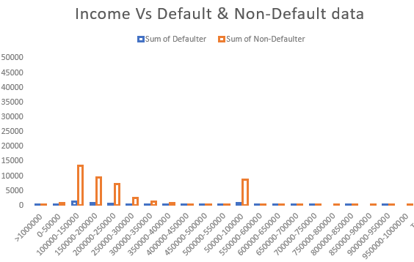
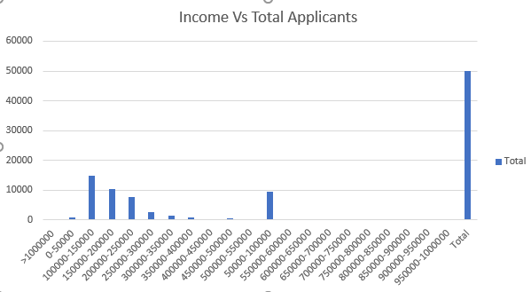
Univariate & Segmented Univariate Analysis For Amt_Income_Total
We used the Excel’s Countif function to identify the Count for Defaulters/Non-Defaulters

Slide 42
Univariate & Segmented Univariate Analysis For Amt_Income_Total
Insights Derived
It is observed that Income range 100000-150000 has the highest amount of Non-defaulters
It is observed that Income range 950000-1000000 has the least amount of Defaulters

Slide 43
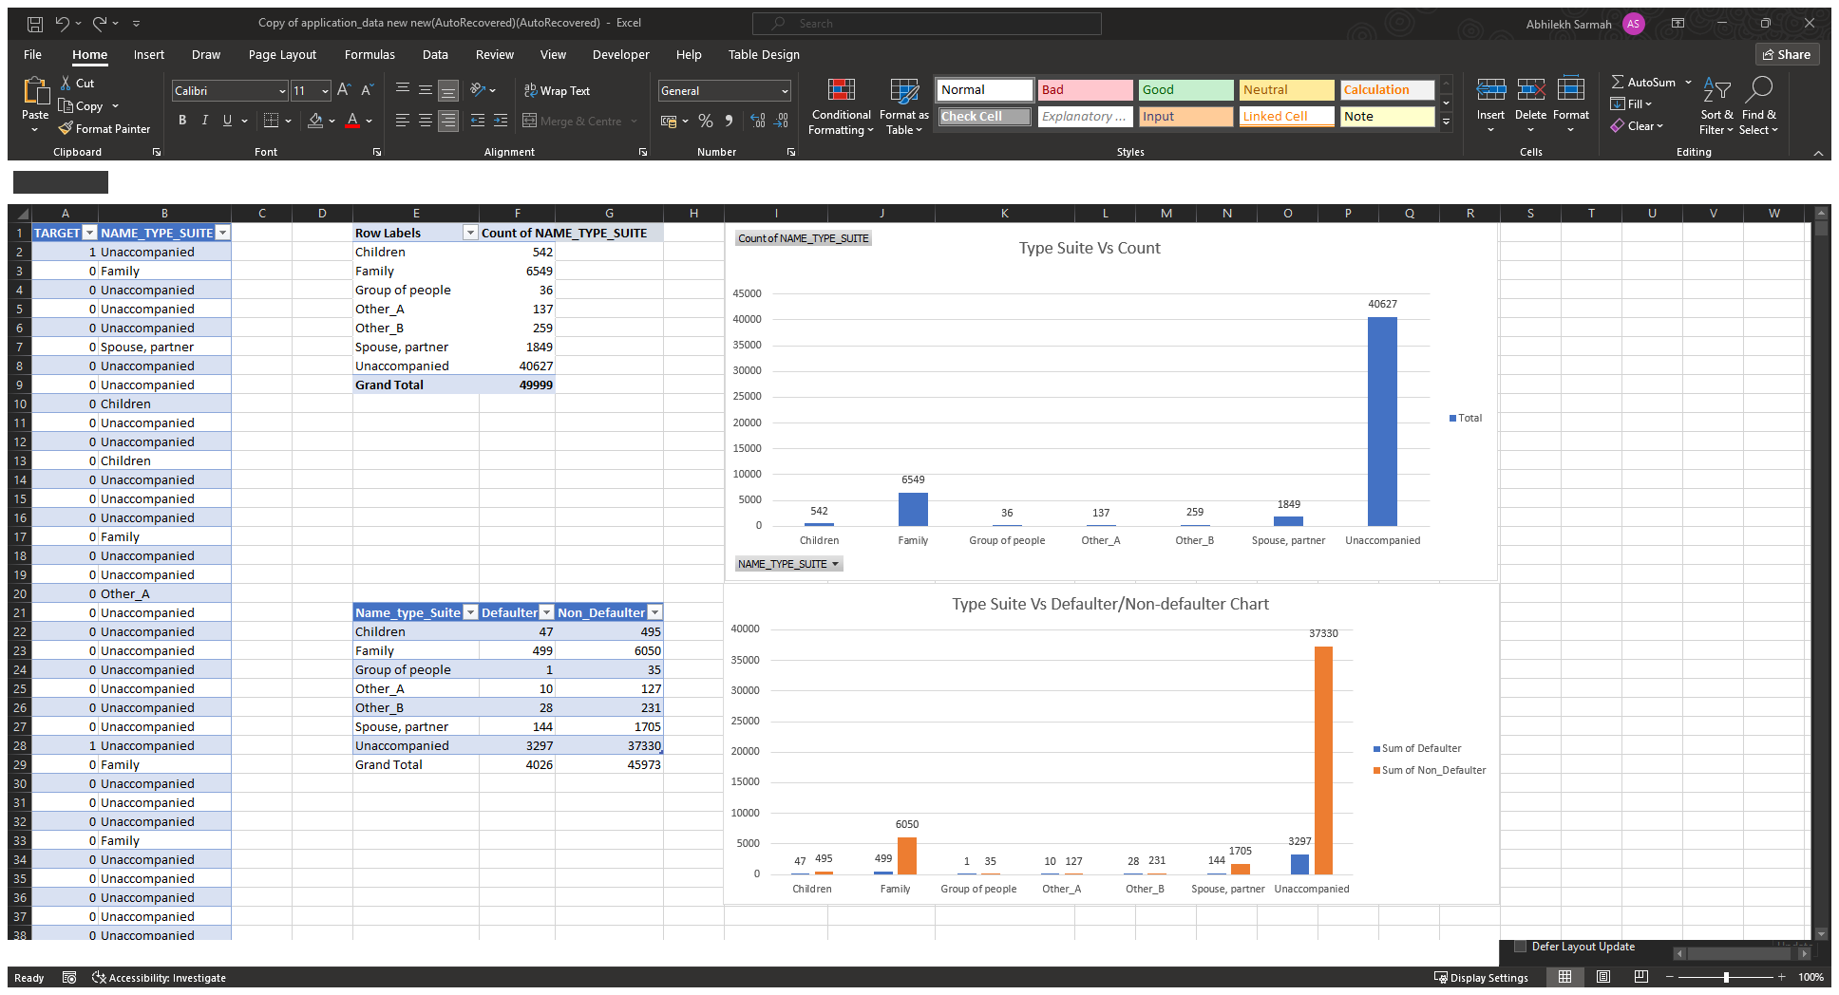
Univariate & Segmented Univariate Analysis For Name_Type_Suite

Slide 44
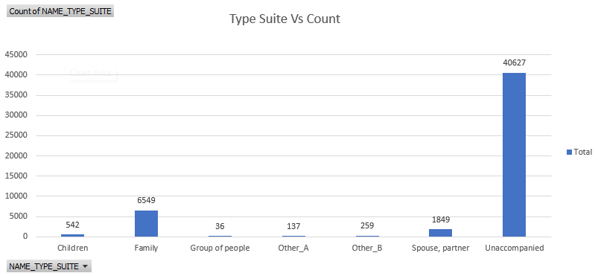
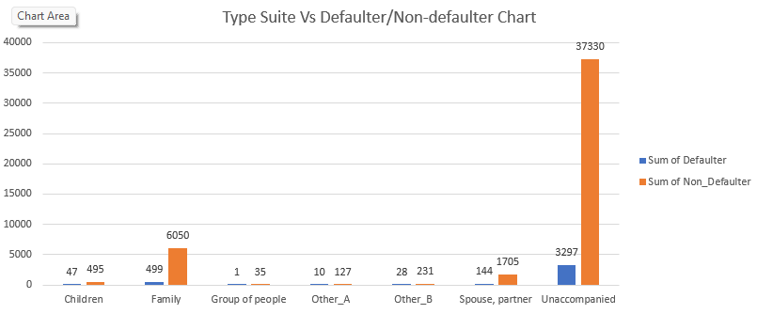
Univariate & Segmented Univariate Analysis For Name_Type_Suite
We used the Excel’s Countif function to identify the Count for Suite Types.

Slide 45
Univariate & Segmented Univariate Analysis For Name_Type_Suite
Insights Derived
It is observed that "Unaccompanied" category has the highest non-defaulters (32,937), indicating stability.
It is observed that "Children" (47) and "Family" (489) have the fewest defaulters, suggesting low risk.
It is observed that "Unaccompanied" also leads in defaulters (1,705), due to its large customer base.
It is observed that Larger groups (e.g., "Unaccompanied") have more defaults, but smaller groups (e.g., "Children") are safer.

Slide 46
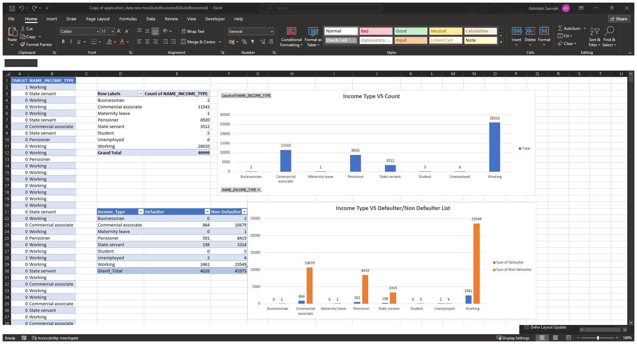
Univariate & Segmented Univariate Analysis For Name_Income_Type

Slide 47
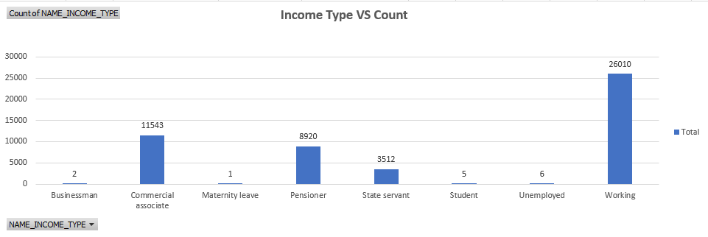
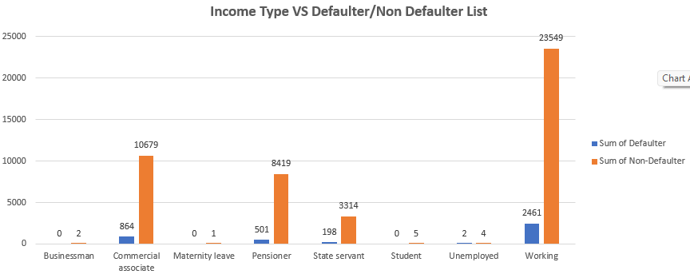
Univariate & Segmented Univariate Analysis For Name_Income_Type
We used the Excel’s Countif function to identify the Count for Income Types.

Slide 48
Univariate & Segmented Univariate Analysis For Name_Income_Type
Insights Derived
It is observed that "Working" has the most non-defaulters (23,549) due to the largest customer base (26,010, 90.5% non-default rate)
It is observed that "Maternity leave" (1) and "Pensioner" (501) have the fewest defaulters, with low risk (0.2% and 5.7% default rates).
It is observed that "Working" leads in defaulters (2,461) but with a moderate 9.5% default rate.
It is observed that "Unemployed" shows the highest default rate (66.7%) with 4 defaulters vs. 2 non-defaulters.

Slide 49
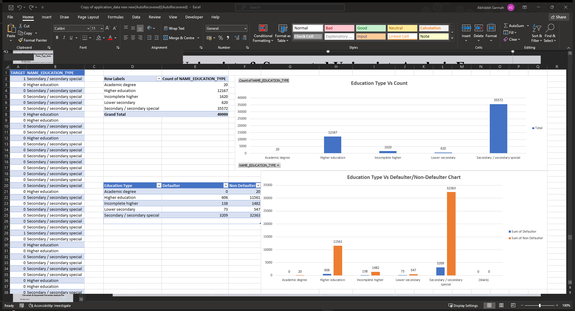
Univariate & Segmented Univariate Analysis For Education_Type

Slide 50
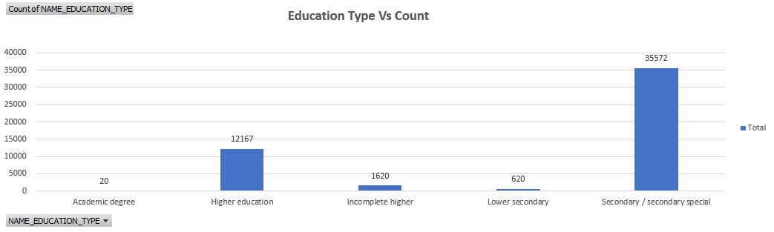
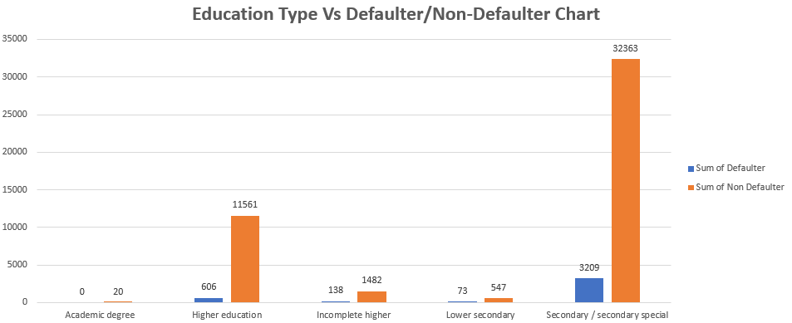
Univariate & Segmented Univariate Analysis For Education_Type
We used the Excel’s Countif function to identify the Count for Education_Type

Slide 51
Univariate & Segmented Univariate Analysis For Education_Type
Insights Derived
It is observed that "Secondary / secondary special" has the most non-defaulters (32,363), due to the largest customer base.
It is observed that "Academic degree" (0) has no defaulters, indicating low risk.
It is observed that "Secondary / secondary special" leads with 3,209 defaulters, likely due to its large population.
It is observed that "Incomplete higher" shows a high rate (48.3%) with 1,482 defaulters vs. 1,138 non-defaulters.
It is observed that Higher defaulters in "Secondary" may reflect lower financial literacy or stability tied to education type.

Slide 52

Univariate & Segmented Univariate Analysis For Name_Family_Status

Slide 53


Univariate & Segmented Univariate Analysis For Name_Family_Status
We used the Excel’s Countif function to identify the Count for Family Status

Slide 54
Univariate & Segmented Univariate Analysis For Name_Family_Status
Insights Derived
It is observed that "Married" has the most non-defaulters (29,699) due to the largest count (~32,094, 92.6% non-default rate).
It is observed that "Unknown" (0) and "Widow" (148) have the fewest defaulters, indicating low risk.
It is observed that "Married" leads with 2395 defaulters, but only amounts to 7.4% default rate due to high count.
It is observed that "Civil marriage" shows the highest rate (9.9%) with 482 defaulters vs. 4,377 non-defaulters.
It is observed that the default numbers align with family type size; smaller groups (e.g., "Widow") have lower defaults.

Slide 55

Univariate & Segmented Univariate Analysis For Housing_Type

Slide 56


Univariate & Segmented Univariate Analysis For Housing_Type
We used the Excel’s Countif function to identify the Count for Housing_Type

Slide 57
Univariate & Segmented Univariate Analysis For Housing_Type
Insights Derived
It is observed that "House/apartment" leads with 40,895 non-defaulters due to the largest count (44,368, 92.2% non-default rate).
It is observed that "Co-op apartment" (15) and "Office apartment" (29) have the fewest defaulters, low risk.
It is observed that "House/apartment" has the most defaulters (3,473), but only 7.8% default rate due to high count.

Slide 58

Univariate & Segmented Univariate Analysis For Occupation_type

Slide 59


Univariate & Segmented Univariate Analysis For Occupation_type
We used the Excel’s Countif function to identify the Count for Occupation_type

Slide 60
Univariate & Segmented Univariate Analysis For Occupation_type
Insights Derived
It is observed that Laborers (24,605) and Sales staff (5,160) have the highest counts.
It is observed that Secretaries and HR Staff have the least number of Defaulter thus indicating risk free occupation types.

Slide 61
Task 5(Identifying Top Correlations for Different Scenarios)
Here I have segmented the dataset based on different scenarios (e.g., clients with payment difficulties and all other cases) and identified the top correlations for each segmented data using Excel functions.
I have utilized Excel functions like CORREL to calculate correlation coefficients between variables and the target variable within each segment. I also have ranked the correlations to identify the top indicators of loan default for each scenario.
I have created correlation matrices or heatmaps to visualize the correlations between variables within each segment. I also have highlighted the top correlated variables for each scenario using different colors or shading.

Slide 62


Task 5(Identifying Top Correlations for Different Scenarios)
Using the Filter function, I have segregated the list for Defaulter and Non-defaulters.

Slide 63


Identifying Top Correlations for Different Scenarios
Using the Correl function, I have segregated the list for Defaulter and Non-defaulters.

Slide 64
Identifying Top Correlations for Different Scenarios
Insights Derived
It is observed that AMT_CREDIT and AMT_GOODS_PRICE correlate at approx. 0.99 in both groups, indicating they carry almost identical information.
It is observed that AMT_CREDIT and AMT_ANNUITY show strong positive correlation (approx. 0.79 non‑defaulters, approx. 0.75 defaulters), which suggests that higher loans come with proportionally higher annuities.
It is observed that AMT_INCOME_TOTAL has near‑zero correlation with DAYS_EMPLOYED implying income size isn’t a primary driver of the number of days employed.
It is observed that the number of children has negligible effect on the amount of loan credited in case of both defaulters and non-defaulters.
It is observed that there is a weak negative correlation between DAYS_BIRTH and REGION_POPULATION_RELATIVE for defaulters (-0.141468873), compared to almost no correlation for non-defaulters (-0.007976329) which suggests that slight tendency for older defaulters to live in less densely populated regions

Slide 65

Analysing the data from Previous_Applications
Similar univariate, segmented Univariate and Bivariate analysis is done for the dataset including previous applications.

Slide 66

Analysing the data from Previous_Applications
Univariate and Bivariate analysis for Type and Status of Loans

Slide 67


Analysing the data from Previous_Applications
Univariate and Bivariate analysis for Type and Status of Loans

Slide 68
Analysing the data from Previous_Applications
Univariate and Bivariate analysis for Type and Status of Loans
Insights Derived:
It is observed that the majority of the loans were Consumer Loans while only a negligible of them amounted to XNA type loans.
It is observed that the majority of the loans were approved indicating a high approval rate by the bank.
It is observed that Consumer loans are both the most‑applied and most‑approved product.
It is observed that Cash loans see nearly as many cancellations (7 199) and refusals (4 741) as approvals, indicating tighter underwriting or more cautious borrowers.
It is observed that Revolving loans sit in the middle, with a roughly 50/50 split between approvals and other outcomes
It is observed that The XNA bucket is negligible but entirely unapproved.

Slide 69

Analysing the data from Previous_Applications
Univariate and Bivariate analysis for loan purpose and client type

Slide 70

Analysing the data from Previous_Applications
Univariate and Bivariate analysis for loan purpose and client type

Slide 71

Analysing the data from Previous_Applications
Univariate and Bivariate analysis for loan purpose and client type

Slide 72
Analysing the data from Previous_Applications
Univariate and Bivariate analysis for Type and Status of Loans
Insights Derived:
It is observed that the Repeater clients dominate (72.3%) – 36,167 of 49,999 total clients.
It is observed that two loan purposes drive 96% volume – 29,143 + 18,821 loans.
It is observed that Repeater loans were mostly seen in the XAP & XNA which might be due to high count in XAP and XNA type loan purposes.
It is observed that very less people apply for loans for Hobby Purpose, almost negligible people applied loan for hobbies. Similar is the case with the purpose of Buying a Garage.

Slide 73
Results
Through this EDA-driven case study, I was able to identify the key factors that influence loan default risk and this helped me sharpen my practical Excel skills:
Identified Critical Risk Drivers
I recognised multicollinearity between AMT_CREDIT and AMT_GOODS_PRICE, and the strong linkage of loan size to annuity.
I discovered that the applicant income had little direct correlation with loan size which helped guide more focused credit‑worthiness assessments.
Enhanced Data‑Quality Practices
I spotted and imputed missing values using median‑based techniques and then visualized data gaps to ensure flawless and robust analysis.
I Flagged outliers using IQR and Quartile functions in Excel and implemented box plots thus validating extreme cases against business rules.
3. Balanced Class Distributions
I pinpointed the class imbalances and recognized the need for errorfree sampling in future occurences.
4. Segmented Correlation Insights
I segmented by payment‑difficulty scenarios and calculated CORREL coefficients, identifying a strong correlation between amount credited and goods price.
5. Confidence booster in Advanced Excel
I learned and applied advanced Excel functions—QUARTILE, IQR, CORREL, COUNTIF—within real‑world risk analytics.
I utilized pivot tables, conditional formatting, and chart tools to convert complex statistical insights into clear visual narratives.
Overall, this project helped me deepen my understanding of banking risk analysis, equipped me with practical Excel techniques for rigorous data analysis, and boosted my confidence in utilising these skills to drive informed lending decisions.

Slide 74
Links
Click here for the Excel Sheet(Application_Dataset)
Click here for the Excel Sheet(Previous_Application_Dataset)
Click here for the Video Presentation

